Slide 1

Capgemini India – PeopleSoft Practice
Capgemini India – PeopleSoft Application Engine

Slide 2
Agenda
Introduction
Application Engine Program Structure
PeopleSoft Application Engine Fundamentals
Creating Application Engine Programs
Adding Sections/Steps and Actions & Properties
Testing Application Engine Programs
Using State Records
Set Processing
Using commits
Using Meta SQL

Slide 3
Capgemini India – PeopleSoft Practice
INTRODUCTION

Slide 4
INTRODUCTION
The Application Engine is a Peopletool designed to help you develop, test and run background SQL processing Programs i.e. you can develop batch or online programs that perform high-volume, background processing against your data.
It is designed for Batch Processing where you have data that must be processed without user intervention
ex : Calculating Salary in Payroll Processing
Converting Money from one Currency to another
You can use PeopleSoft Application Engine for straight, row-by-row processing, but the most efficient Application Engine programs are written to perform set-based processing.

Slide 5
Application Engine Program Types
There are five types of Application Engine programs. You specify the type in the Program Properties dialog box for your program definition. The types are:
Standard, which is a normal entry-point program.
Upgrade Only, which is used in PeopleSoft upgrade utilities.
Import Only, which is used by PeopleSoft import utilities.
Daemon Only, a type of program used as a daemon process.
Transform Only, a program type used to support Extensible Stylesheet Language Transformations (XSLT).

Slide 6
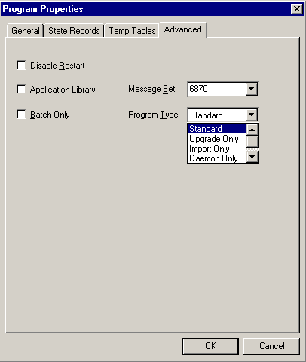

Slide 7
Capgemini India – PeopleSoft Practice
APPLICATION ENGINE PROGRAM STRUCTURE

Slide 8
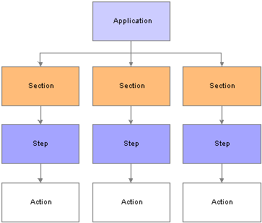
APPLICATION ENGINE PROGRAM STRUCTURE

Slide 9
Capgemini India – PeopleSoft Practice
KEY ELEMENTS OF APPLICATION ENGINE & FUNDAMENTALS

Slide 10
Key Elements of Application Engine
Key Elements of Application Designer are:
Section :
A Section is a set of steps that gets executed as part of Program
You can call Sections from Steps within other Sections
All Application Engine Programs Must contain at least one Section entitled “MAIN”
Steps :
A Step is a smallest unit of work that can be committed within a program.
typically you use a step to execute a SQL statement or to call another section.
When a section gets called, its steps execute sequentially.

Slide 11
Actions :
The SQL or PeopleCode that a step executes are the actions within the step.
It is common to have multiple actions associated with a single step.
There are multiple types of actions that you can specify to include within a step. They are :
Do Actions :
Do While
Do When
Do Select
Do Until
SQL
Peoplecode
Log Message
Call Section

Slide 12
Do When
The Do When action is a SELECT statement that allows subsequent actions to be executed if any rows of data
The Do When statement runs before any other options in the Step
If the Do When statement returns any rows, the next Action will be executed.
A Do When Action is executed just once when a step is executed

Slide 13
Do While
The Do While Action runs each time before the next Action is repeated.
If the Do While Returns any rows of data,all the Actions in the step will be repeated.
If no rows are returned, Application Engine will move on to the next step or Section.

Slide 14
Do Select
The Do Select Action is a SELECT statement that executes subsequent Actions once for every row of data that the Do Select produces.
The subsequent Actions within the Step as executed in a loop based on the results of the SELECT statement.
The type of the Do Select determines the specific looping rules

Slide 15
Do Until
A Do Until Action is a SELECT statement that executes subsequent Actions once for every row of data that the Do Select produces
Use a Do Until if you want the “processing actions” to execute atleast once and to execute over and over until a certain condition is true
You can use Do Until to stop a Do Select prematurely.

Slide 16
SQL
Most SQL actions contain a single SQL statement. These actions can perform the following types of SQL statements:
Update
Delete
Insert
Select
SQL action does not control the flow of the program.

Slide 17
Peoplecode
provides an excellent way to build dynamic SQL, perform simple if/else edits, set defaults, and other operations that don't require a trip to the database.
It also enables you to reference and change active Application Engine state records.
PeopleCode provides access to the PeopleSoft integration technologies such as PeopleSoft Integration Broker, Component Interfaces, Business Interlinks, and file processing.

Slide 18
PeopleCode
Property :
  On Return : The On Return setting takes effect if your PeopleCode program issues a “return 1” or “exit 1.” You can use the True keyword in place of a non-zero numeric return.
    Abort : The program issues an error and exits immediately.
    Break : The program exits the current step and section, and control returns to the calling step.
    Skip Step : The program exits the current step, and continues processing at the next step in the section. If this is the last step in the section, the calling step resumes control of the processing.

Slide 19
Log Message
You use a Log Message action to write a message to the message log based on a condition in your program.
Gives your Program Multilanguage capability.
The system stores the message generically as a message set, message number, and parameter values.
When a user views the messages using the Application Engine Message Log page, the system retrieves the appropriate message string from the message catalog based on the user’s language preference.

Slide 20
Call Section
The called section can be in the same program as the calling section, or it can be in an external program.
Enables you to chunk your program into more maintainable, reusable pieces.
PeopleSoft Application Engine supports up to 99 levels of nested Call Section actions.

Slide 21
Capgemini India – PeopleSoft Practice
CREATING APPLICATION ENGINE PROGRAM

Slide 22
Using The Defination view
The Definition view is where you create your definitions within a defined hierarchical structure. Within the metaphor of the definition view, nodes represent the definitions.
A node is the visual representation of a section, step, or action that you can select, collapse, modify and so on.
The sections that appear in the Definition view do not necessarily appear in the order that they will execute. To see the actual order in which the sections, or the entire program for that matter, executes, switch to the Program Flow view.

Slide 23
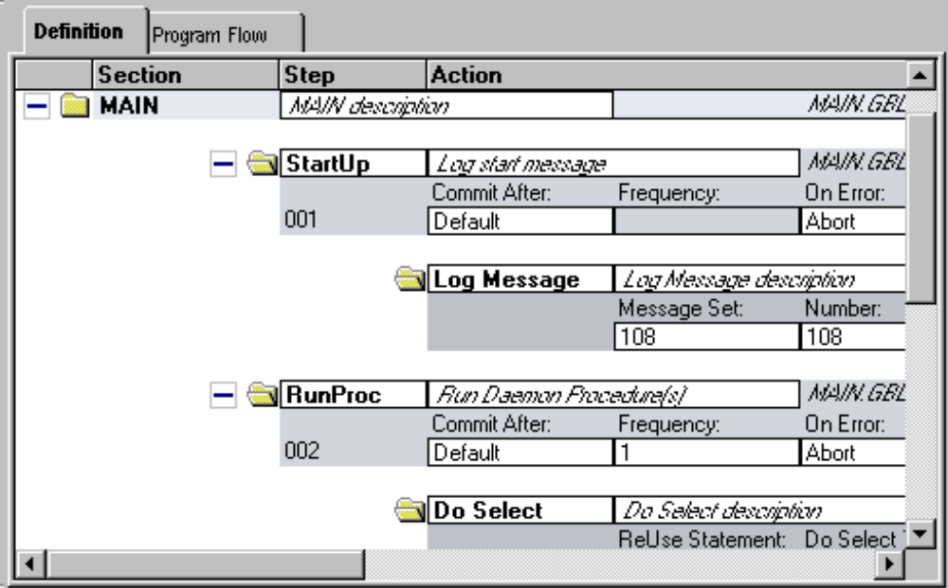
PeopleSoft Application Designer Definition view

Slide 24
Definition View Pop-up Menu
View PeopleCode
View SQL
View XSLT
Cut, Copy, Paste, delete
Refresh View
Insert Section
Insert Step/Action
Insert Action
Print

Slide 25
View PeopleCode : Launches the PeopleCode Editor with the appropriate PeopleCode loaded. Enabled when a PeopleCode action is selected.
View SQL : Launches the SQL Editor with the appropriate SQL loaded. Enabled when an action containing SQL is selected.
View XSLT : Launches the SQL Editor with the related XSLT text
loaded. Enabled for Transform program types only, when an XSLT action is selected.

Slide 26
Insert Section : Inserts a new Application Engine section into the current program where the cursor is positioned. This option is enabled only when you have MAIN or another section selected.
Insert Step/Action : Inserts a new Application Engine step and action within the currently selected Application Engine section. This option is enabled only when you have a section or a step selected.
Insert Action : Inserts a new Application Engine action within the currently selected step. This option is enabled only when you have a step or action selected.

Slide 27
Capgemini India – PeopleSoft Practice
SECTION PROPERTIES

Slide 28
Section Properties
Section Name :Develop a naming convention and be consistent throughout your projects.
Market :Select the market for which the section is intended.
Effective Date :To make a particular section effective-dated, enter the target date.
Effective Status :Specify whether a section is active, or enabled at runtime.
Section Type :In the case of an abnormal termination of the program, the value of this system field specifies whether you must restart the section.
Auto Commit :Select to specify the commit level for the section.
Public :Select to enable a section to be called from another program.

Slide 29
Capgemini India – PeopleSoft Practice
STEP PROPERTIES

Slide 30
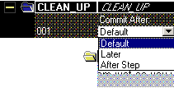
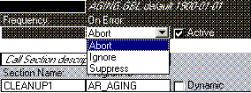
Step Properties

Slide 31
Step Name :Enter a name
Commit :Specify the commit level for the step
Default: Select to inherit whatever commit level you specified for the section in which the step resides.
Later: Select to postpone the commit until a subsequent commit occurs.
After Step: Select if you have a commit level of None specified at the section level.
Frequency :Enabled only when a step contains one of the following actions: Do While, Do Select, or Do Until.
On Error :Specify how PeopleSoft Application Engine should respond to an error at the step level.
Abort: The application terminates with an error message.
Ignore: The program continues but logs an error message.
Suppress: The program continues and presents no error message.
Status :Select to activate a step.

Slide 32
Capgemini India – PeopleSoft Practice
ACTION PROPERTIES

Slide 33




Action Properties

Slide 34
there are different sets of properties specific to a particular action type. Depending on the action type you select, the properties that appear change.
ReUse Statement Property
The ReUse Statement property is available for all SQL action types
the ReUse Statement property is used to optimize the SQL in your batch program.
ReUse Statement is a way to combat potential performance decreases.

Slide 35
When setting the ReUse Statement option, choose between these values:
Bulk Insert :
This option turns on ReUse Statement, and, in addition, it holds all the data in a buffer and performs an insert only after a large volume of rows has gathered in the buffer.
Storing data in the buffers is applicable only if you’ve selected Bulk Insert and the SQL is an Insert statement.
No :Select this option to disable ReUse Statement.
Yes :Select this option to enable basic ReUse Statement functionality.

Slide 36
No Rows Property
We use this property to specify what the Application Engine program should do If the SQL (Insert, Update, or Delete) associated with the SQL action does not return any rows.
When you set the No Rows property, you choose from the following values:
Abort :The program terminates.
Section Break :PeopleSoft Application Engine exits the current section immediately, and control returns to the calling step.
Continue :The program continues processing.
Skip Step :PeopleSoft Application Engine exits the current step immediately and moves on to the next step.

Slide 37
Capgemini India – PeopleSoft Practice
STATE RECORD

Slide 38
State Record
A State Record is the method by which you allocate variables for your Application Engine program, created and maintained by Application Engine Developer
You can have any number of state records associated with a particular Application Engine program. However, only one record can be the default state record.
You can specify both work (derived) and physical (SQL table) records to be used as state records.
It is used as a worktable –
To hold the initial values
To pass values to program steps from prior Sections, Step and Actions
To hold the results of SQL Selects
As a source for values for SQL Updates,Inserts,Deletes…
Computed values or counters

Slide 39
Characteristics :
The State name must end with _AET identifier
Must have one key – Process Instance
%SELECT stores data into the State Record
%BIND gets data out of the State Record
We can have none or multiple State Records

Slide 40
Capgemini India – PeopleSoft Practice
SET PROCESSING

Slide 41
Set Processing
The real secret to gaining outstanding performing with Application Engine Programs is to employ a technique called Set Processing
Set Processing uses SQL to process groups, or sets of rows at one time rather than processing each row individually.
You only select those rows that meet the filtering criteria and then run the rule once against all the affected rows
The bulk of the performance gain lies in the fact that the processing occurs in the database
Temporary Tables are used to achieve optimum performance in your Batch Program

Slide 42
Advantages :
Improved Performance
Minimized SQL overhead
Easy maintenance
Leveraging the RDBMS

Slide 43
Capgemini India – PeopleSoft Practice
APPLICATION ENGINE COMMIT

Slide 44
Application Engine Commit
For New Application Engine programs, by default ,the commit values at the section and the step level will be tuned off i.e. no commits will occur after the successful completion of the program.
You can divide your program into logical units of work by setting commit points within your program for ex after completion of a self-contained task.
If you have a step with a Do While, Do Until or a Do Select Action, you can set frequency option which drives your commit level

Slide 45
Capgemini India – PeopleSoft Practice
META SQL

Slide 46
META SQL
Meta-SQL expands to platform-specific SQL substrings, causes another function to be called, or substitutes a value. Meta-SQL constructs are used in functions that pass SQL strings
Application Engine meta-SQL is divided into the following categories:
Construct.
A construct is a direct substitution of a value, which helps to build or modify a SQL statement.
Examples include %Bind, %InsertSelect
Function.
A function performs an action on its own or causes another function to be called.
Examples include %ClearCursor, %Execute
Meta-variable.
A meta-variable allows substitution of text within SQL statements.
Examples include %AsOfDate, %Comma

Slide 47
Some META SQL elements used in Application Engine are :
%SELECT
%BIND
%TruncateTable
%Execute
%UpdateStats

Slide 48
%Select
Syntax
%Select(statefield1[, statefield2]...[, statefieldN])
Select field1[, field2]...[, fieldN]
Description :
Use the %Select construct to identify the state record fields to hold the values returned by the corresponding Select statement.
The %Select construct is required at the beginning of all Select statements.
You use the %Select construct to pass variables to the state record

Slide 49
%Bind
Syntax
%Bind([recordname.]fieldname [, NOQUOTES][, NOWRAP][, STATIC])
Description
Use the %Bind construct to retrieve a field value from a state record. Can be used anywhere in a SQL statement. When executed, %Bind returns the value of the state record field identified within its parentheses.
the type of field in the state record that you reference with %Bind must match the field type of the corresponding database field used in the SQL statement.
In the case of an external call to a section in another program, if the called program has its own default state record defined, then PeopleSoft Application Engine uses that default state record to resolve the %Bind(fieldname).

Slide 50
%TruncateTable
Syntax
%TruncateTable(table name)
Description
Use the %TruncateTable construct to invoke a bulk delete command on a table.
it's best to use this construct early in your Application Engine program as an initialization task.
It's functionally identical to a Delete SQL statement with no Where clause, but it is faster on databases that support bulk deletes.
You should commit after the step that immediately precedes the step containing the %TruncateTable statement.

Slide 51
%Execute
Syntax
%Execute([/]) command1{; | /} command2{; | /}... commandN{; | /}
Description
Use the %Execute function to execute database-specific commands from within your Application Engine program.
enables you to include multiple statements in a single Application Engine action without encountering database-specific differences.
By default, PeopleSoft Application Engine expects a semicolon to be used to delimit multiple commands within an %Execute function statement.

Slide 52
Thank you

